Slide 1
JavaScript development frameworks
Introduction to Angular 5

Slide 2
Course objectives
Introduction to JavaScript. Overview
Basic http handling
Building a web server with NodeJS
NodeJS. Request and response, HTML templates, JSON data
NodeJS routing
ExpressJS
NPM, build tools
File management. Promises
Introduction to TypeScript
Introduction to Angular 5
Angular modules, applications, components
Angular services
Angular templates
Observables in Angular
Routing in Angular

Slide 3
Learning objectives
Introduction to Angular 5

Slide 4
Angular since 5.x
The next major version of the Angular framework
A development platform than just a framework
Mobile first, future ready, powered by open source community
Faster, better tooling, more flexible,…

Slide 5
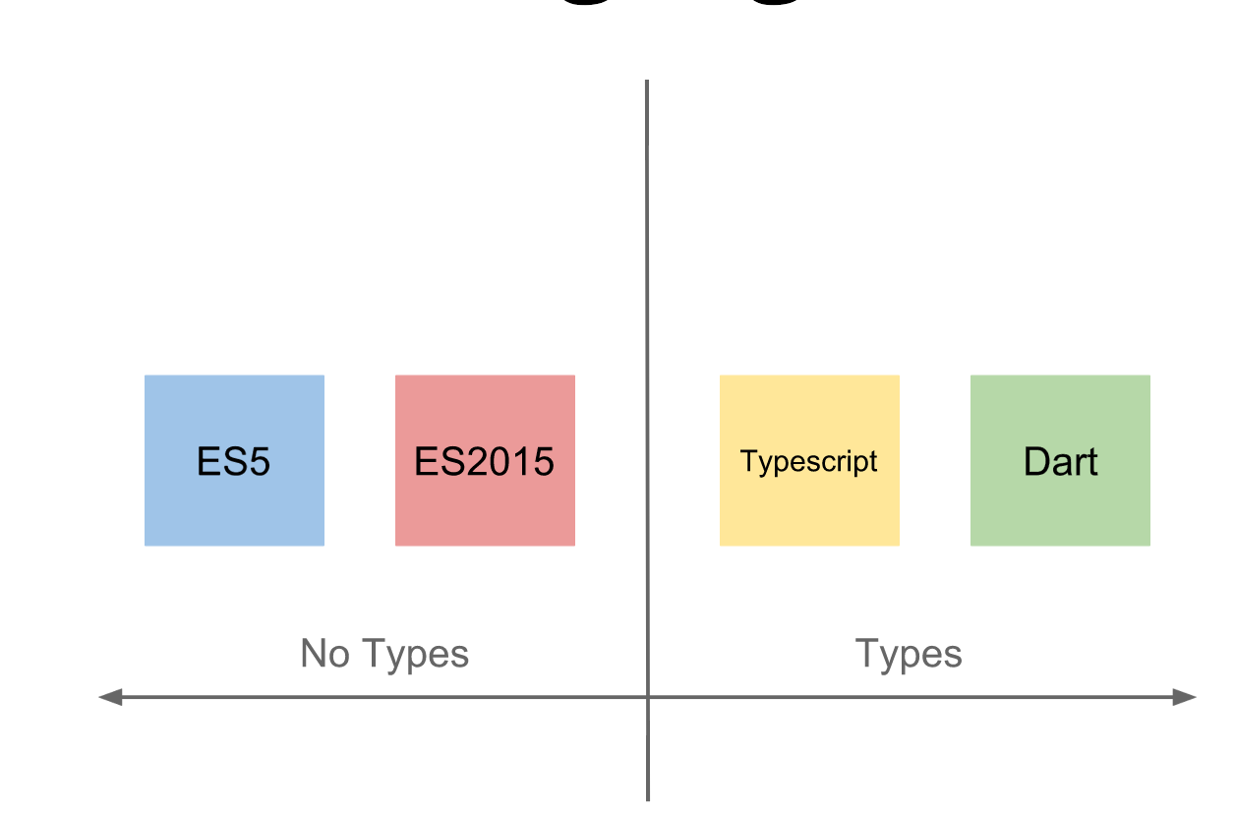
Languages

Slide 6
Resources
https://angular.io
https://gitter.im/angular/angular
Blogs and tutorials

Slide 7
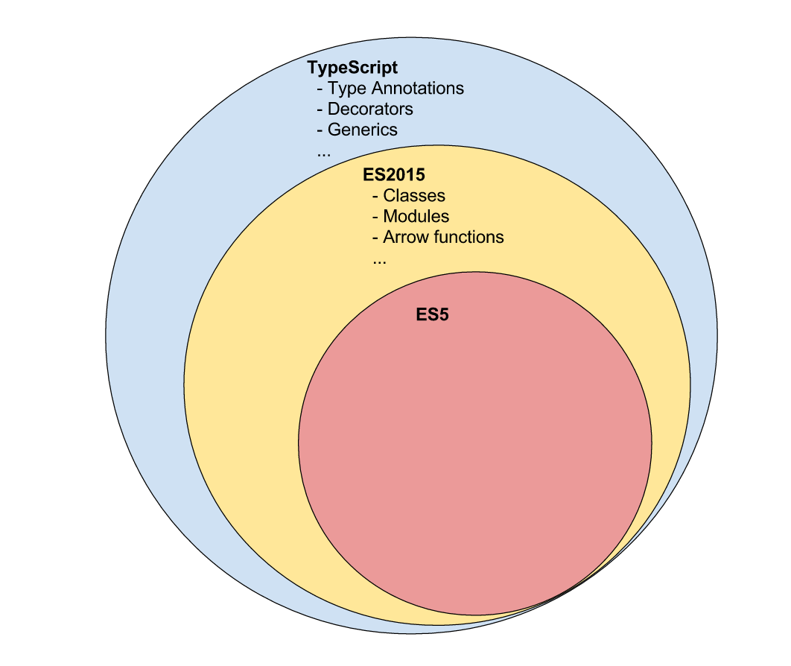
ES2015/TypeScript basics

Slide 8
TypeScript basics - classes
class Car {
manufacturer:string;
constructor(manufacturer:string = 'BMW') {
this.manufacturer = manufacturer;
}
drive(miles:number) {}
}
let bmw = new Car();

Slide 9
TypeScript basics - inheritance
class Car { ... }
class Convertible extends Car {
}
let cabrio = new Convertible();

Slide 10
TypeScript basics - Modules
ES2015 brings a module system which enables to write modular code
Each .ts/.js file is a module
Using export/import to create and use modules

Slide 11
TypeScript basics - Modules
// Car.js
export class Car { ... }
export class Convertible extends Car { ... }

Slide 12
TypeScript basics - Modules
// App.js
import {Car, Convertible} from 'Car';
let bmw = new Car();
let cabrio = new Convertible();

Slide 13
Key differences between Angular 1.x and 5.x
Modules
Controllers to components
Structural directives
Data binding
Services
Dependency injection
Removal of many directives

Slide 14
Angular 5 application structure
NgModules (different from ES2015 modules)
Components
Services
Templates
Styles, Pipes,…
Keep in mind that every component, service, pipe (etc.) is a part of a NgModule

Slide 15
Angular 5 – bootstrap a module
Bootstrapping (different than Twitter’s Bootstrap framework)
Tells Angular where to start
Tells Angular how to start

Slide 16
Angular 5 – bootstrap a module
import { platformBrowserDynamic } from '@angular/platform-browser-dynamic';
import { ContactsModule } from './app/app.module';
platformBrowserDynamic().bootstrapModule(ContactsModule);

Slide 17
Angular 5 – bootstrap a module
Upgrades located DOM element into Angular componenet
Creates injector for the application
Creates Shadow DOM on component’s host element
Instantiates specified component
Performs change detection

Slide 18
Angular 5 – Angular CLI
Command line interface for Angular
Contains many useful commands to instantiate, create and test the application

Slide 19
Demo

Slide 20
Tasks

